Slide 1
FACADE Design Pattern
A Structural Design Pattern
Mohammed Ibrahim

Slide 2
Content
Introduction (What does the word FACADE mean?)
FACADE as Design Pattern
Code Example-1
Code Example 2
Conclusion
References

Slide 3
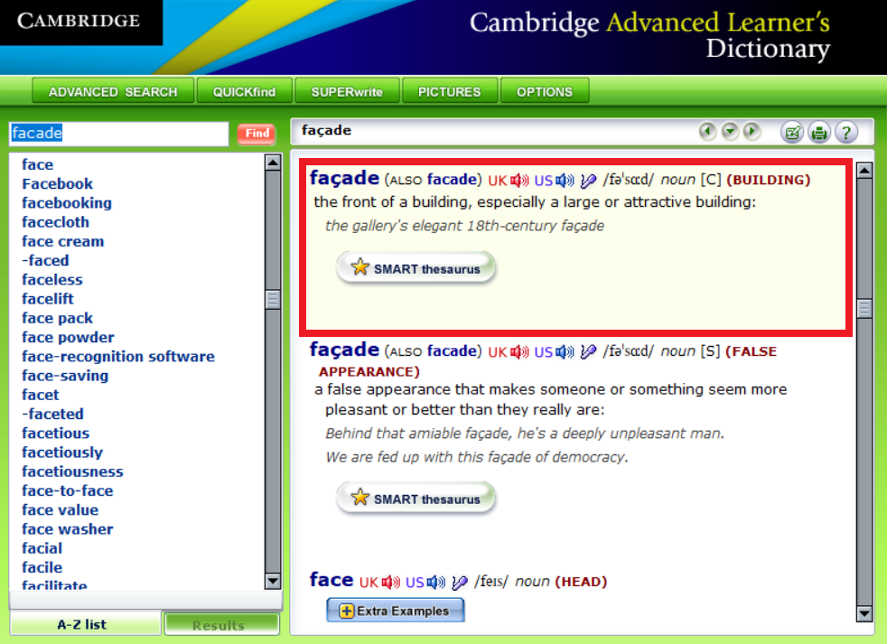
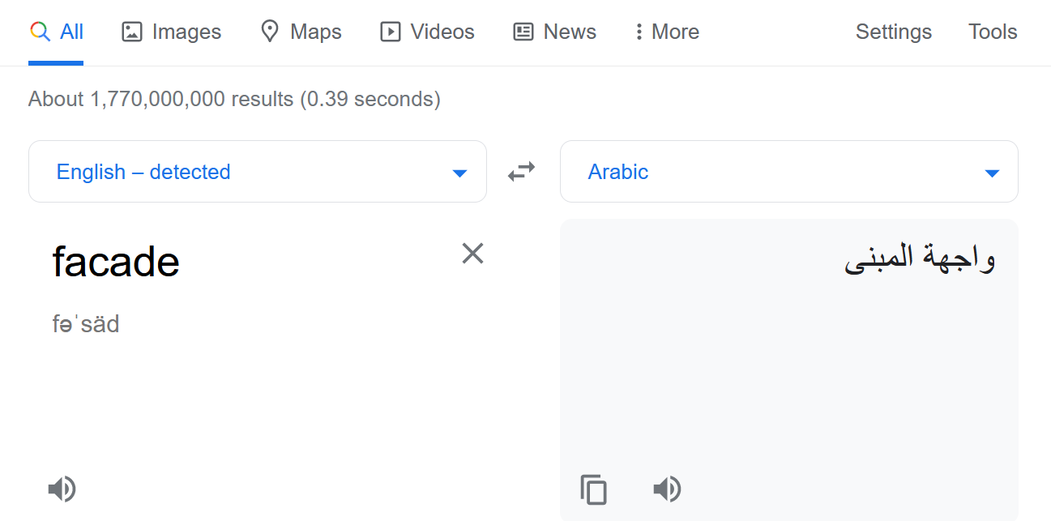
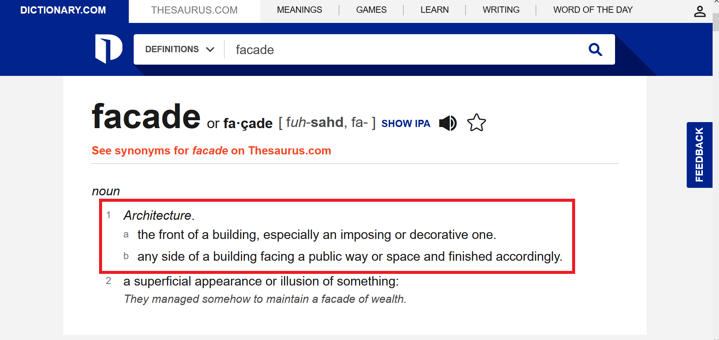

Slide 4
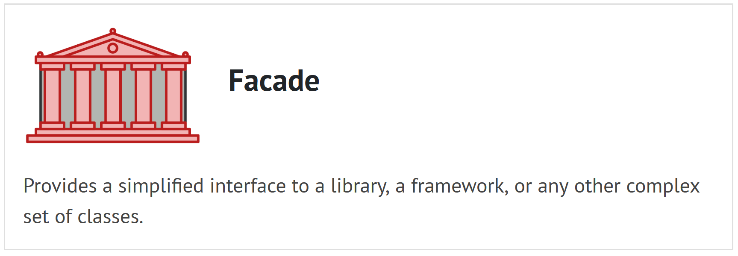

Slide 5
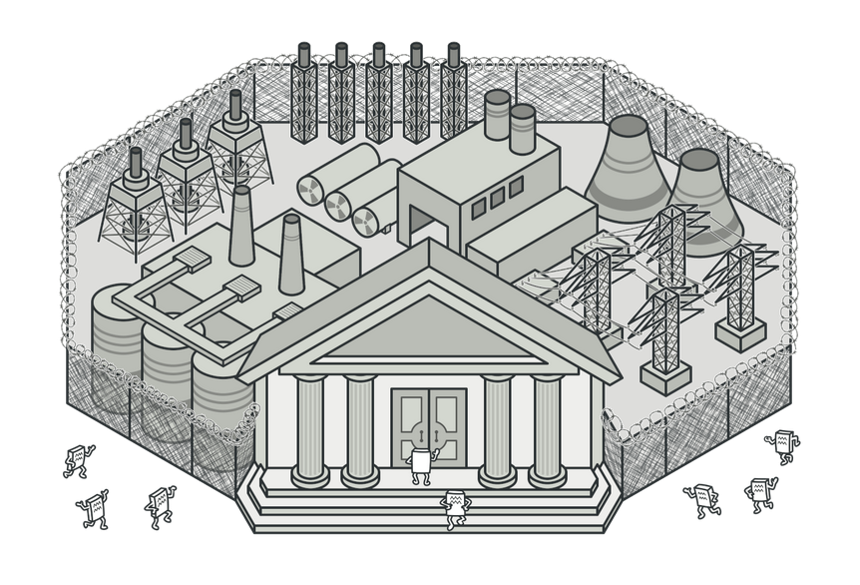

Slide 6
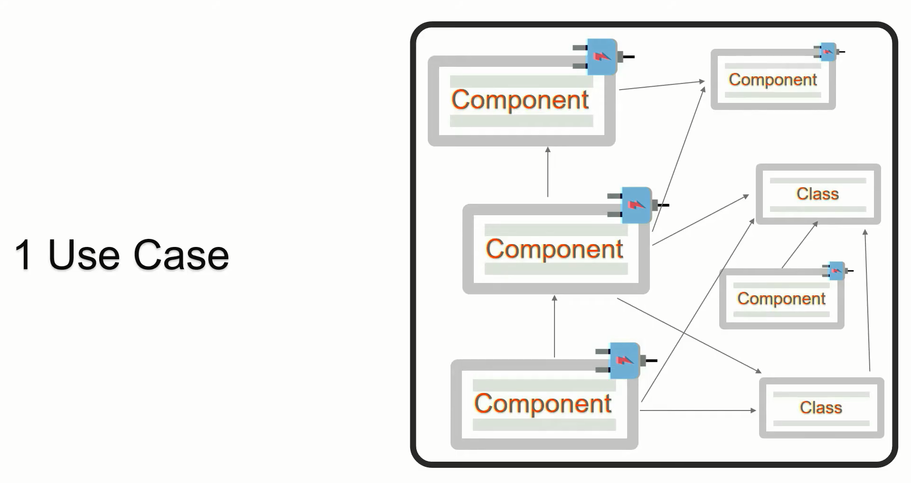

Slide 7
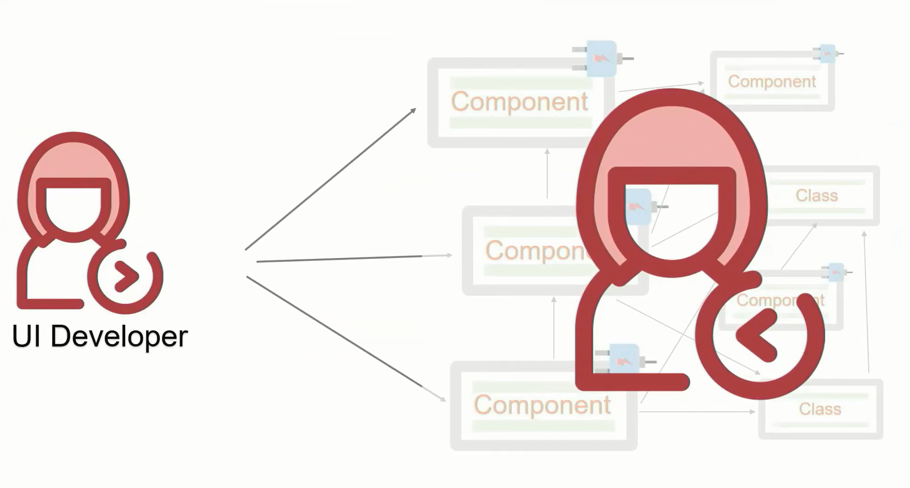

Slide 8
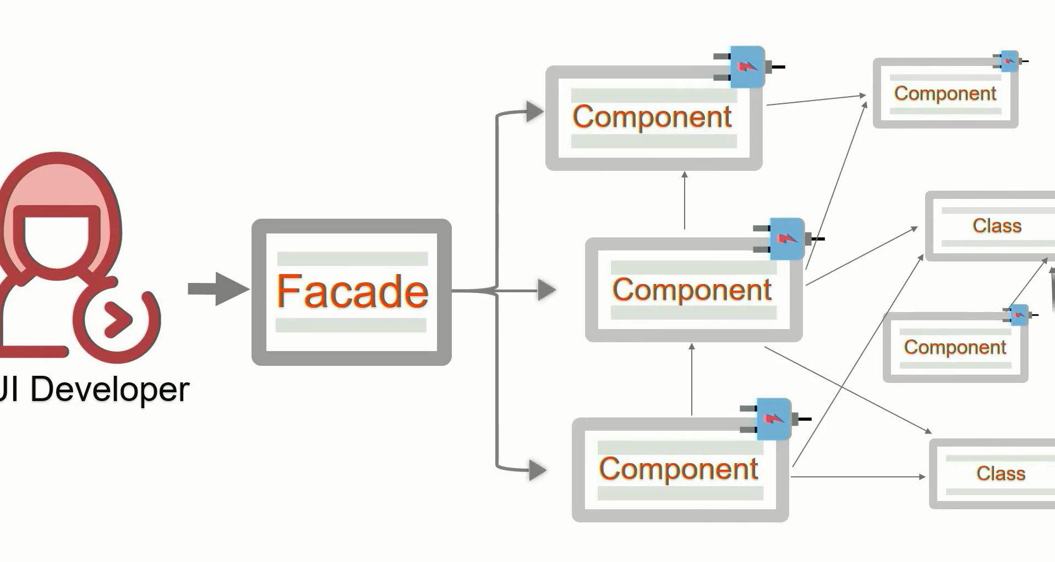

Slide 9
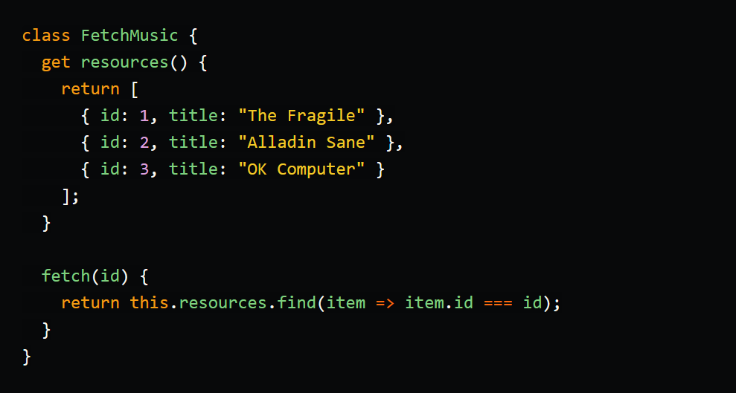
Code Example-1

Slide 10
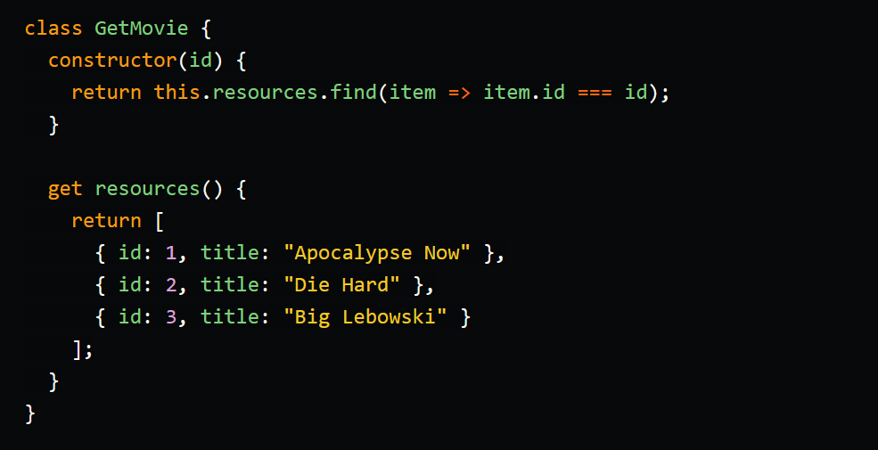

Slide 11
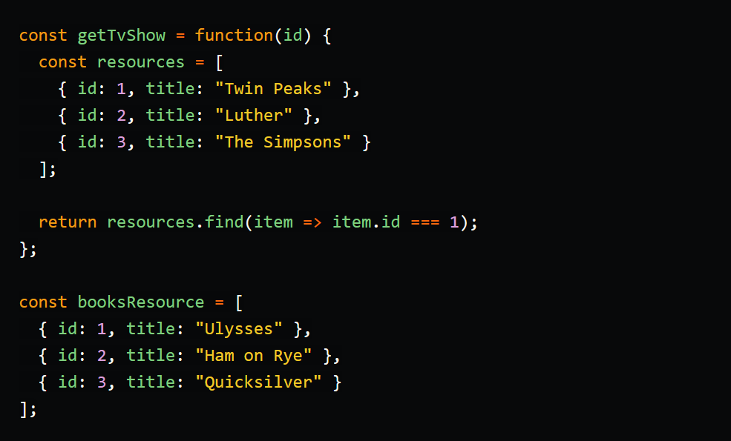

Slide 12
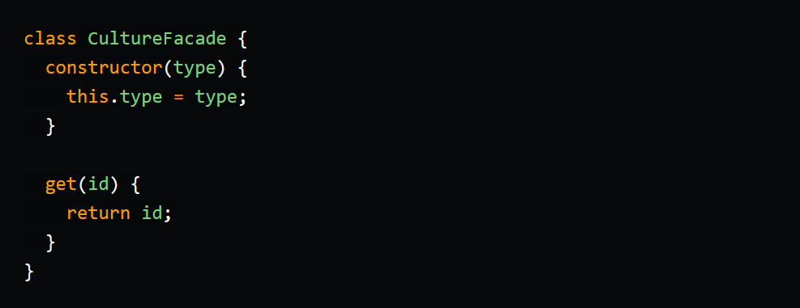

Slide 13
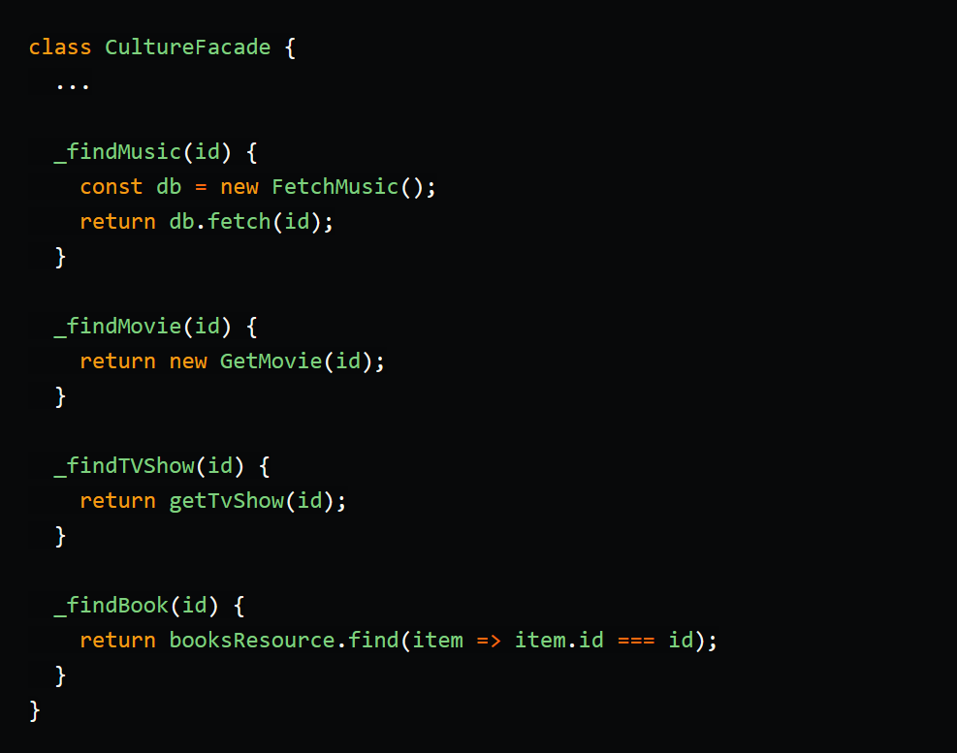

Slide 14
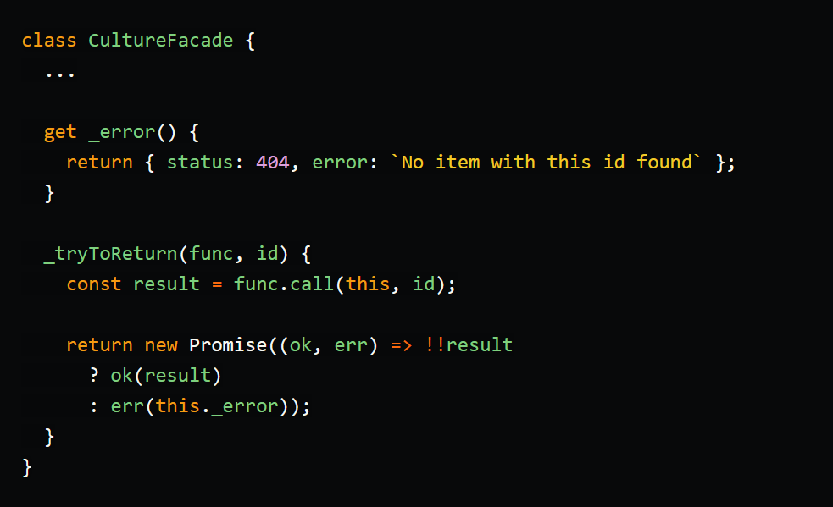

Slide 15
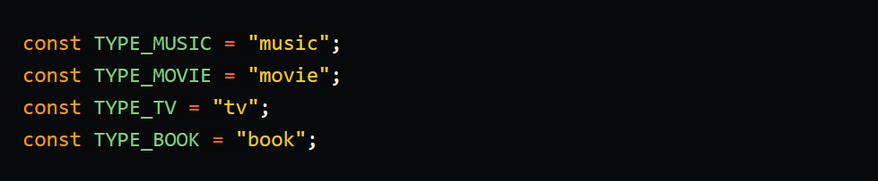

Slide 16
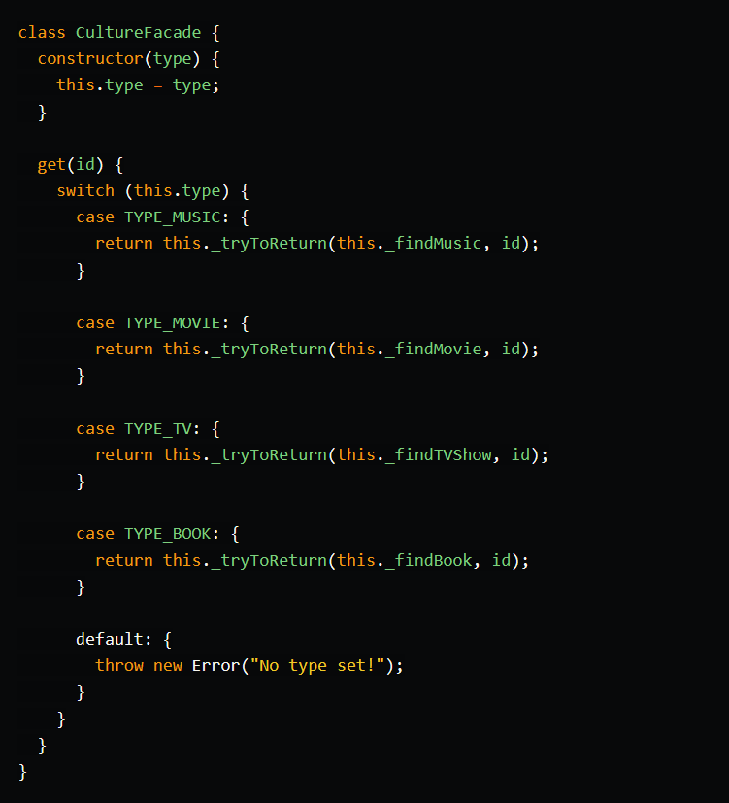
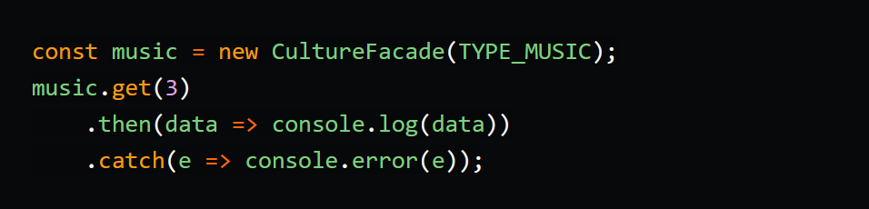

Slide 17
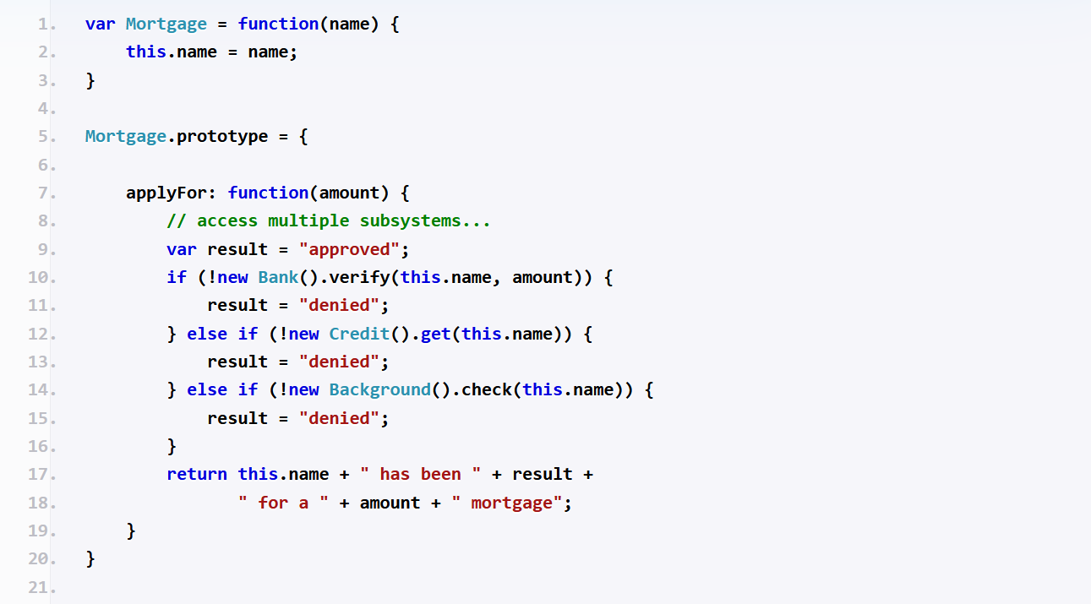
Code Example-2

Slide 18
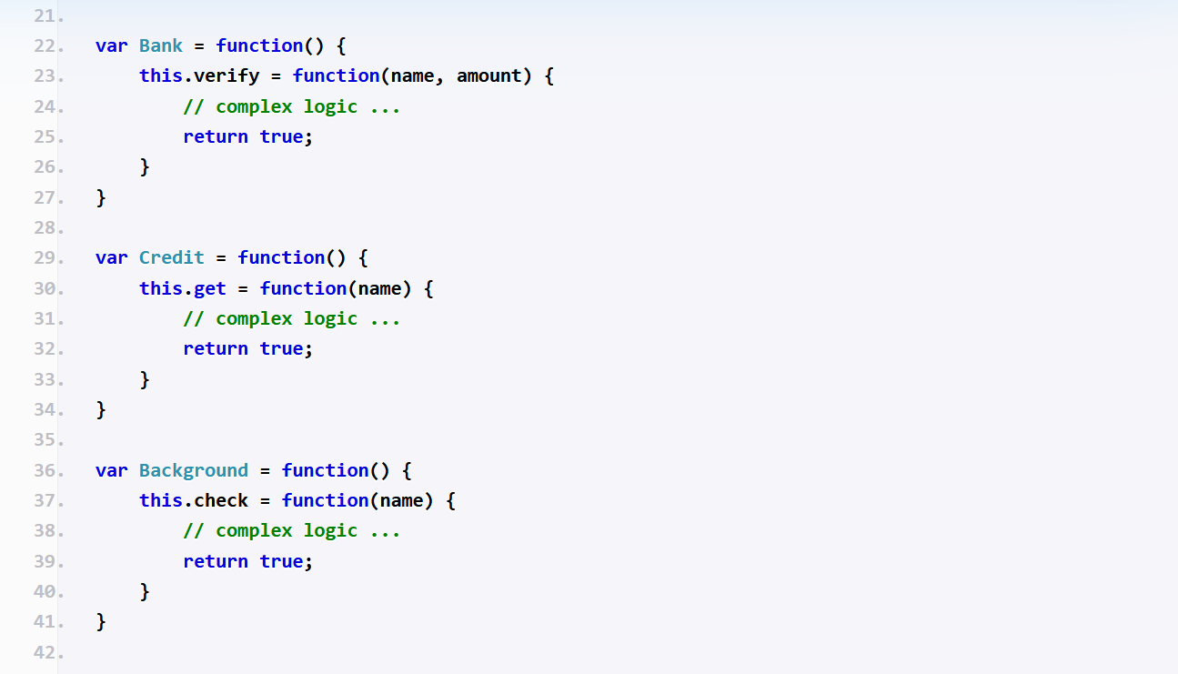

Slide 19
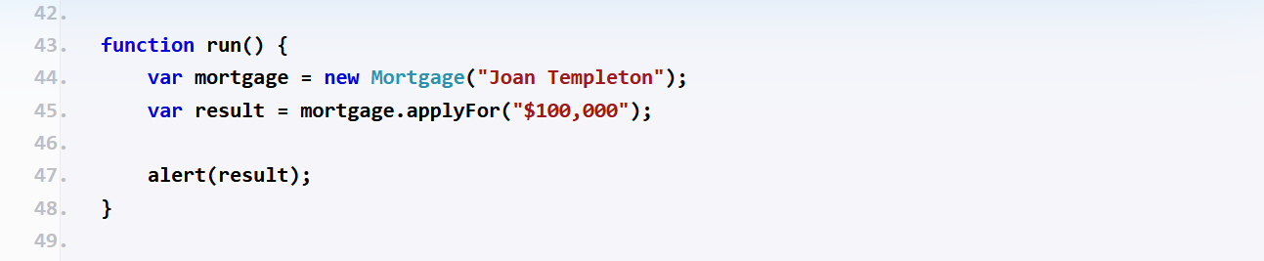

Slide 20
Conclusion
Provides an undefined and simplified interface in a subsystem.
Hides the complexities of the subsystem from the client.
Client is forced to know the low level details.

Slide 21
References
https://www.dofactory.com/javascript/design-patterns/facade
https://dev.to/tomekbuszewski/facade-pattern-in-javascript-3on4
https://refactoring.guru/design-patterns/facade

Slide 22
Thank you

